Slide 1


Team
Idiosingcrasies
Progress Report and Direction
Music Mind and Technology - S23.CS9.434
Vivek Mathur
Siddik Ayyappa
Shri Vidhatri

Slide 2
Outline
The Literature Review Recap
Previous work
Research gap
Excerpt Selection Strategies
Mechanism of Data collection
Post Data Collection Strategy

Slide 3
The Literature Review Recap
M.M.Shri Vidhatri

Slide 4
Previous work on Timbre
Alluri, V., & Toiviainen, P. (2010). Exploring perceptual and acoustical correlates of polyphonic timbre. Music Perception, 27(3), 223-242.
Pitt, M. A. (1994). Perception of pitch and timbre by musically trained and untrained listeners. Journal of experimental psychology: human perception and performance, 20(5), 976.

Slide 5
Polyphonic Timbre
This paper provides us with the introduction on multidimensional timbre space
The aim of the work was to investigate
the consistency and predictability of semantic associations of listeners to polyphonic timbre
to determine the most salient features of polyphonic timbre perception by investigating the descriptive auditory qualities of music
mapping acoustic features to these descriptors

Slide 6
With results from experiment with participants, the following 8 scales were selected for the perceptual task:
‘Colorful-Colorless,’‘Warm-Cold,’ ‘Dark-Bright,’ ‘Acoustic-Synthetic,’ ‘Soft-Hard,’ ‘Strong-Weak,’ Empty-Full,’ and ‘High Energy-Low Energy’
Based on the Inter-scale correlations(ISC) given in this paper, these 8 scales were reduced to 5 scales due to the restrictions of our project (The scales with less ISC are selected)
Warm - Cold
Acoustic - Synthetic
Colourful - Colourless
Empty - Full
High Energy - Low Energy

Slide 7
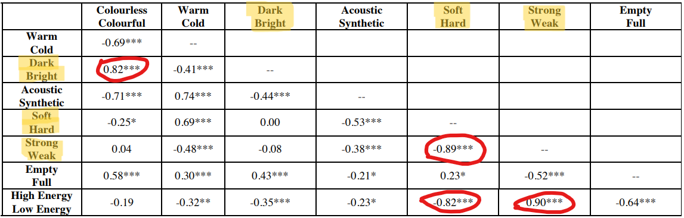
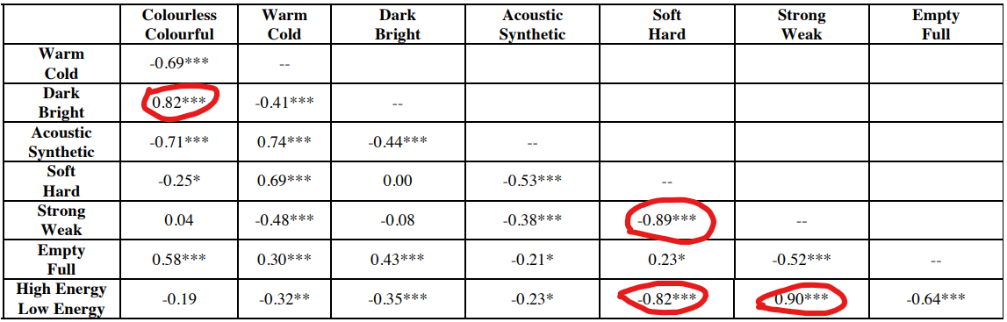
Selection of Scales

Slide 8
Musicians vs Non-Musicians
The purpose of this study was to explore how pitch and timbre interact in perception in musicians and nonmusicians
This was done by changing pitch and/or timbre and observing the difference in perception between non-musicians and musicians
The results of the experiment showed that non-musicians show an asymmetry in which timbre is perceptually more salient than pitch, whereas musicians showed no such bias.

Slide 9
Research gap
The literature review gives information regarding the
perception of multidimensional timbre in music using various perceptual scales
effect of pitch on the timbre perception of musicians and non-musicians
There is a research gap in the understanding the difference in perception of multidimensional timbre between musicians and non musicians independent from pitch, amplitude, melody and harmony.

Slide 10
General hypothesis of the project
Research shows that the brains of musicians have stronger structural and functional connections compared to those of non-musicians. Similar studies have been conducted which conclude that the perception of music varies among from musicians to non-musicians.
Thus, this project aims to study the difference between the perception of timbre between musicians and non musicians, with the hypothesis that timbre perception among musicians will be more consistent as compared to nonmusicians.

Slide 11
Strategy to do project - 1
Excerpt Selection Strategies
Vivek Mathur

Slide 12
Solution description
Use Pre- provided excerpts of Indian Music; taken from a research paper’s Supplementary Informations for preliminary testing and priming of subject.
Run Through Songs of interest in Matlab; make temporal graphs; Identify Interesting parts in songs, Identify other markers in the music, and take these interesting excerpts to the survey respondent.

Slide 13
Why Do this at all?
The initial few questions on the survey will allow us to have a sanity check as to whether the general trend of non separate respondents is matching with that which is expected from prior research findings
The further questions will allow us to drill down further and assess deeply the way the subjects assess both western and indian song excerpts.
I hypothesize and expect a positive correlation between the subject’s perceptions and the MirToolBox detections for western music and a negative correlation between the subject’s perceptions and the MirToolBox detections for Indian music Stimuli.

Slide 14
Mechanism of Data Collection
Siddik Ayyappa

Slide 15
Mechanism
It has been decided that google forms shall be used to collect data from users, regarding the songs.
The google form asks all the required questions and collect the answers.
The user shall have access to the audio excerpt signal in the form of a YouTube Embed. The user will be able to listen to the audio signal multiple times, pause it, loop it, slow it down or speed it up.
The user shall be asked to answer 5 questions regarding each audio excerpt.
All the data shall be collected into an excel sheet and can be extracted into a csv file.
Anyone who has experience with music (Instruments or Vocals) are considered as musicians in the survey.

Slide 16
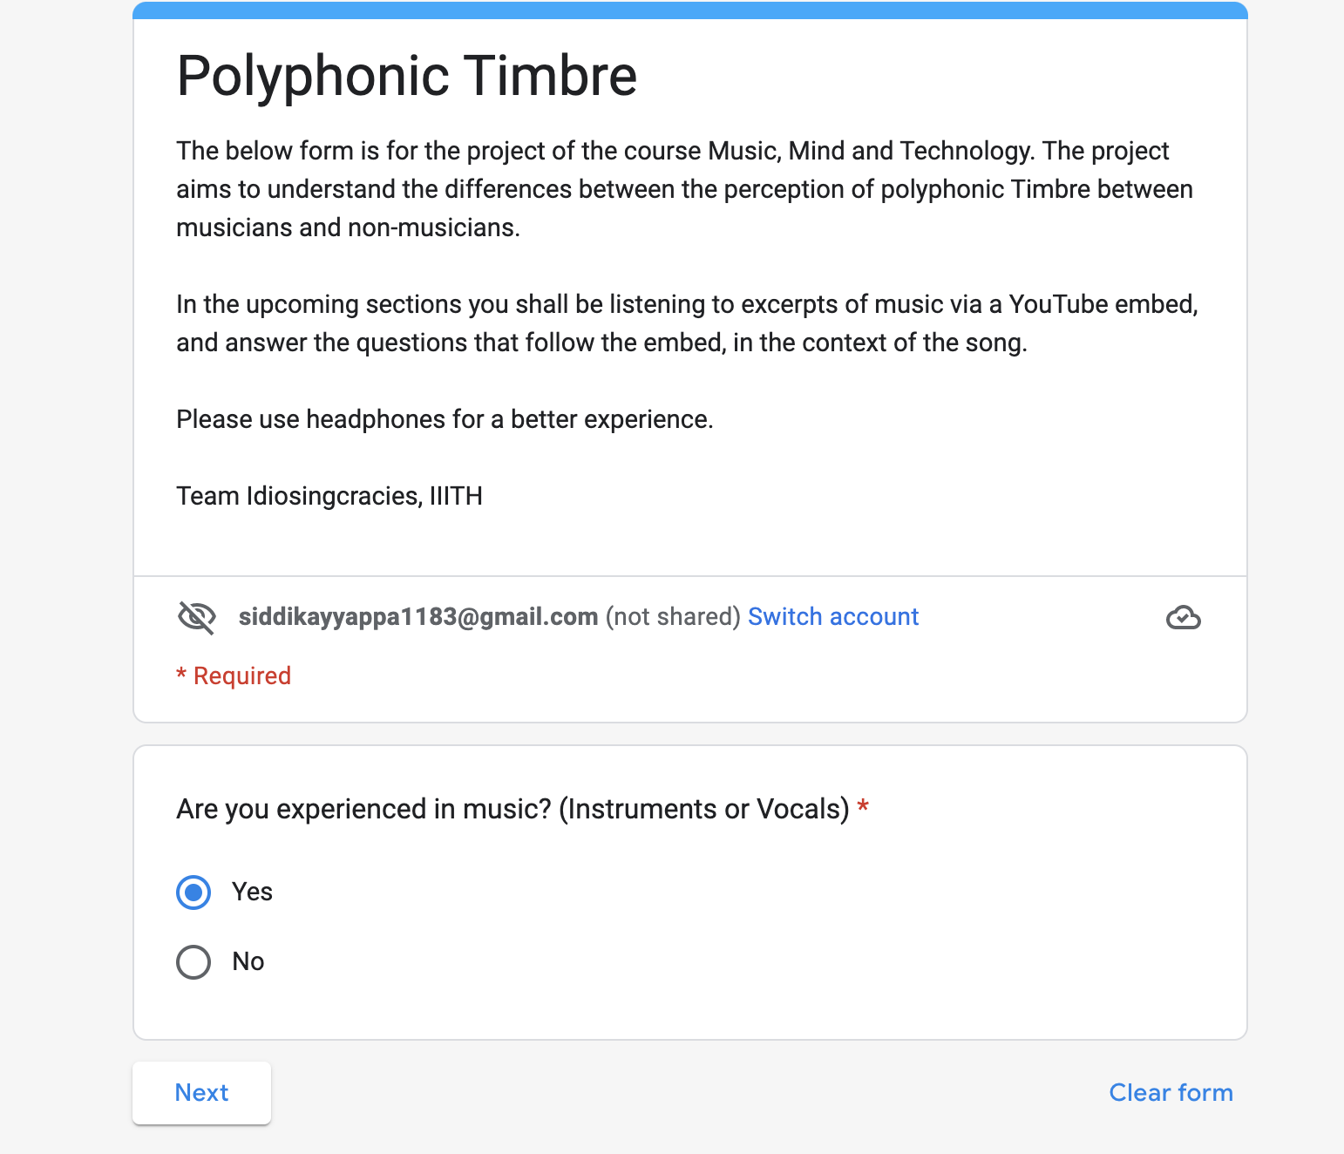
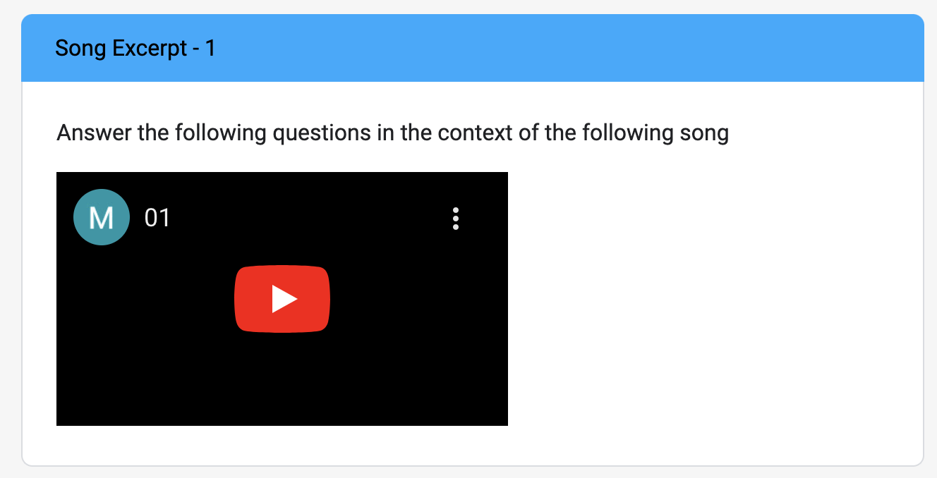
Images of the Form

Slide 17
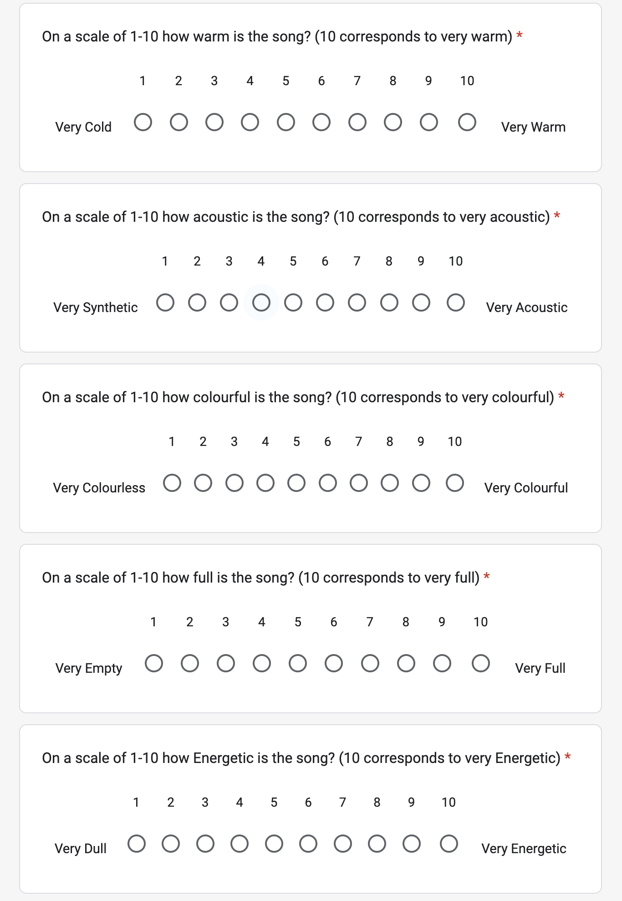
The Questions which follow the embed

Slide 18
Post Data Collection Strategy
Siddik Ayyappa

Slide 19
Post Data Collection Strategy
We shall be performing the same analysis from research paper, [source] on 2 different sets and 5 perceptual scales.
The first set we will be performing the analysis on, is the set of subjects with musical experience. The other one is the set of subjects with no musical experience.
We shall perform feature extraction on the audio signals users listen to.
Then we shall perform Correlations between the timbre values and acoustic features for the data obtained for both sets of people.
Our team hypothesizes that the best acoustic cues which describe polyphonic timbre for set of people with musical experience and the other set shall be different, which would imply that musicians and non-musicians perceive polyphonic timbre in a different manner.

Slide 20
Questions?

